Slide 1
HDDS1104 Operating Systems and Networking
Topic 7b - IP, Routing

Slide 2
Intended Learning Outcomes
Explain the Internet Protocol
Explain the principles of Routing
Apply TCP/IP knowledge for simulation in Cisco Packet tracer

Slide 3
Network Layer (OSI)
Provides
Inter-networking function (IP)
Packet Forward
Congestion Control function: TCP Layer
Routing function (IP)

Slide 4
Internet Protocol (IP)
Network layer communication protocol
Relaying datagram across network boundaries
Routing function
Inter-networking
TCP/IP
Connectionless datagram service to TCP

Slide 5
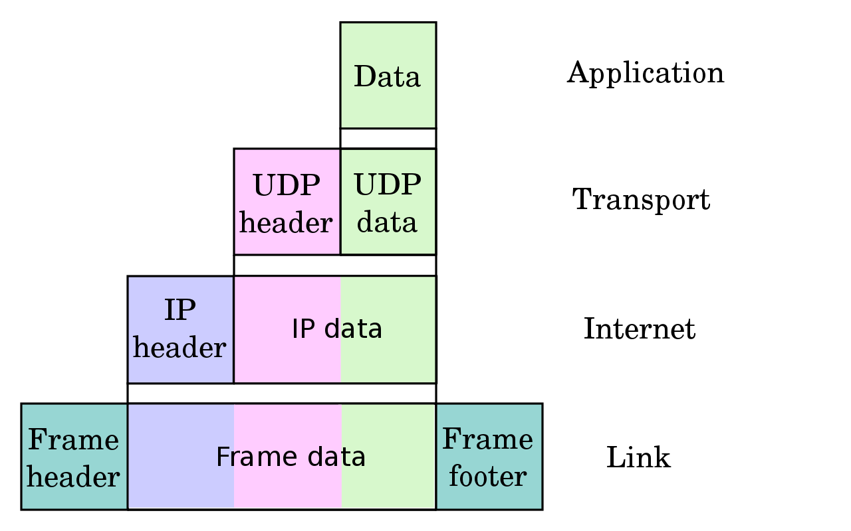
Encapsulation of application data (Recall from Topic 5)
Datagram /
Segment
Packet
Frame
Source: https://en.wikipedia.org/wiki/Internet_Protocol#/media/File:UDP_encapsulation.svg

Slide 6
Routing Algorithms

Slide 7
Routing
Graph abstraction
Distance Vector vs Link State
Dijkstra's Algorithm
Bellman-Ford Algorithm

Slide 8
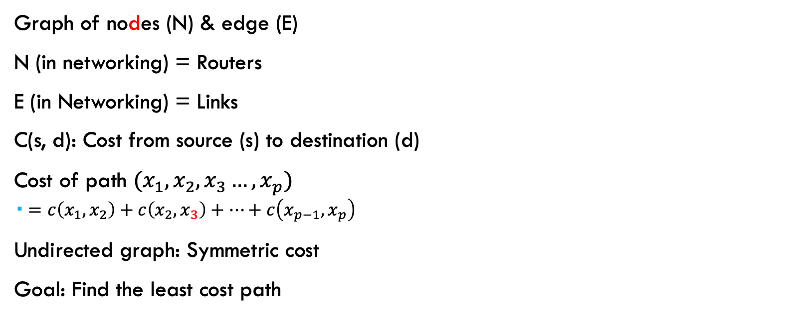
Graph Notation
Graph of nodes (N) & edge (E)
N (in networking) = Routers
E (in Networking) = Links
C(s, d): Cost from source (s) to destination (d)
Cost of path $(x_{1}, x_{2}, x_{3}…, x_{p})$
$=c\left(x_{1},x_{2}\right)+c\left(x_{2},x_{3}\right)+…+c\left(x_{p−1},x_{p}\right)$
Undirected graph: Symmetric cost
Goal: Find the least cost path

Slide 9
Graph of Network
N = {u, v, w, x, y, z}
E = {(u,v), (u, x), (u, w), (v, x), (v, w), (x, w), (x,y), (w,y), (w,z), (y,z)}
5
3
v
w
2
5
3
u
z
2
1
1
x
y
2
1

Slide 10
Distance Vector
5
Distance Vector
Vector of distances to all nodes,
e.g.: u: {u:0, v:2, w:5, x:1, y:2, z:4}
Sent to neighbors,
e.g.: u will send to v, w, x
Large vectors to small # of nodes
Tell about the world to neighbors
Older method. Used in Routing Information Protocol (RIP).
3
v
w
2
5
3
u
z
2
1
x
y
2
1
1

Slide 11
Link State
5
Vector of link cost to neighbors
Example: u: {v:2, w:5, x:1}
Sent to all nodes,
Example u will send to v, w, x, y, z
Small vectors to large # of nodes
Tell about the neighbors to the world
Newer method. Used in Open Shortest Path First (OSPF).
3
v
w
2
5
3
u
2
z
1
1
x
y
2
1

Slide 12
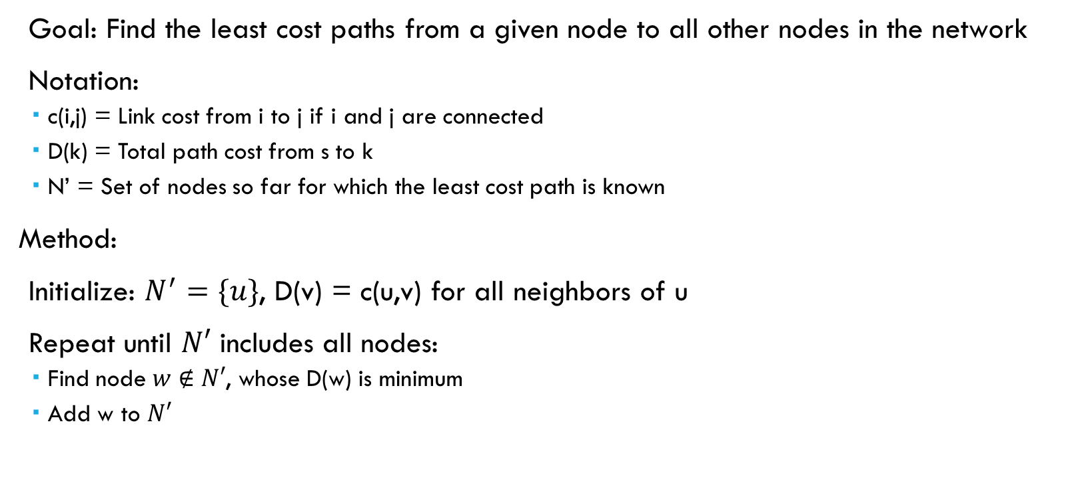
Dijkstra's algorithm
Goal: Find the least cost paths from a given node to all other nodes in the network
Notation:
c(i,j) = Link cost from i to j if i and j are connected
D(k) = Total path cost from s to k
N’ = Set of nodes so far for which the least cost path is known
Method:
Initialize: $N^{′}=\{u\}$, D(v) = c(u,v) for all neighbors of u
Repeat until $N′$ includes all nodes:
Find node $w∉N′$, whose D(w) is minimum
Add w to $N′$
https://en.wikipedia.org/wiki/Dijkstra%27s_algorithm

Slide 13
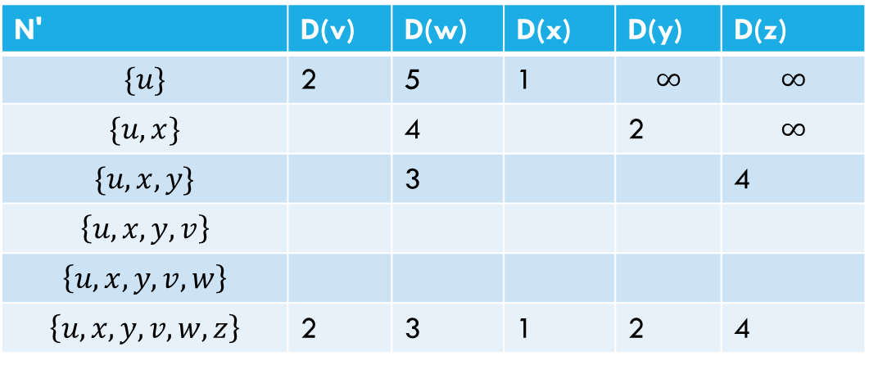
Example
N' | D(v) | D(w) | D(x) | D(y) | D(z)
$$\{u\}$$ | 2 | 5 | 1 | $$∞$$ | $$∞$$
$$\{u, x\}$$ |  | 4 |  | 2 | $$∞$$
$$\{u, x, y\}$$ |  | 3 |  |  | 4
$$\left\{u, x, y,v\right\}$$
$$\left\{u, x, y,v, w\right\}$$
$$\left\{u, x, y,v, w, z\right\}$$ | 2 | 3 | 1 | 2 | 4
5
v
3
w
2
5
3
u
2
z
1
1
x
y
2
1

Slide 14
Dijkstra Algorithm
By Ibmua - Work by uploader., Public Domain, https://commons.wikimedia.org/w/index.php?curid=6282617
Notes:
By Ibmua - Work by uploader., Public Domain, https://commons.wikimedia.org/w/index.php?curid=6282617

Slide 15


Bellman-Ford Algorithm
Notation:
u = Source node
c(i,j) = link cost from i to j
h = Number of hops being considered
$D_{u}(n)$ = Cost of h-hop path from u to n
Method:
Initialize:
$D_{u}\left(n\right)=∞ for all n≠u$
$D_{u}(u) = 0$
For each node,
$D_{u}\left(n\right)=\min\left(D_{u}\left(j\right)+c\left(j, n\right)\right)$
If any costs change,
repeat step 2

Slide 16




















Example of Bellman-Ford Algorithm
5
5
3
$$2$$
3
$$5$$
$$∞$$
$$∞$$
5
5
2
2
3
0
3
$$∞$$
0
2
1
$$∞$$
2
1
1
$$∞$$
$$∞$$
2
1
$$1$$
$$∞$$
2
1
1
5
5
$$2$$
3
$$4$$
3
2
5
$$2$$
$$3$$
5
2
0
3
$$10$$
3
2
1
0
2
1
$$4$$
1
$$1$$
$$2$$
2
$$1$$
$$2$$
2
1
1
1

Slide 17
Autonomous Systems (AS)
An internet connected by homogeneous routers under the administrative control of a single entity
Presents a common & clearly defined routing policy to the internet
Single Entity
(Typically) Internet Service Provider (ISP)

Slide 18
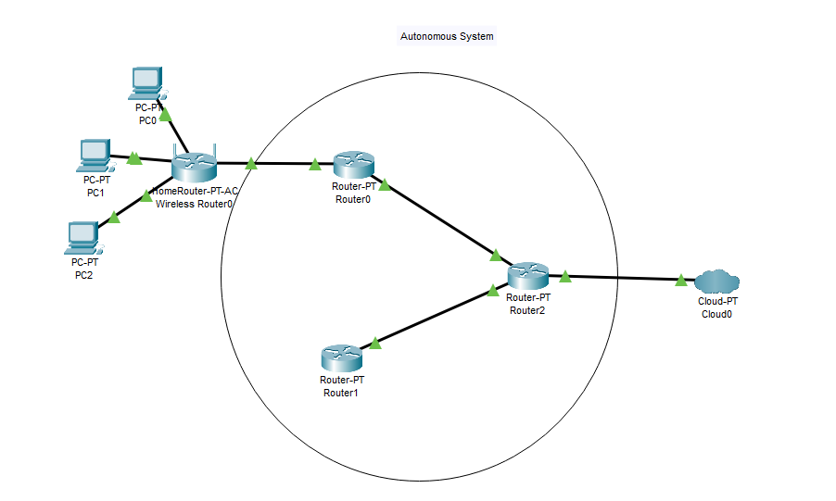
Autonomous System - Example

Slide 19
Routing Protocols
Interior Router Protocol (IRP):
Used for passing routing information among routers internal to an autonomous system.
Also known as IGP.
Examples: RIP, OSPF, IGRP
Exterior Router Protocol (ERP):
Used for passing routing information among routers between autonomous systems.
Also known as EGP.
Examples: EGP, BGP, IDRP
Note: EGP is a class as well as an instance in that class.

Slide 20
Open Shortest Path First (OSPF)
Uses true metrics (not just hop count)
Uses subnet masks
Allows load balancing across equal-cost paths
Supports type of service (ToS)
Allows external routes (routes learnt from other autonomous systems)
Authenticates route exchanges
Quick convergence
Direct support for multicast
Link state routing ⇒Each router broadcasts its connectivity with neighbors to entire network

Slide 21
Border Gateway Protocol
Inter-autonomous system protocol [RFC 1267]
Used since 1989 but not extensively until recently
Runs on TCP (segmentation, reliable transmission)
Advertises all transit ASs on the path to a destination address
A router may receive multiple paths to a destination
Can choose the best path
iBGP used to forward paths inside the AS.
eBGP used to exchange paths between ASs.

Slide 22
Command – tracert / traceroute
Trace Route: Trace the path of IP
Windows: tracert
Mac: traceroute
Use varying IP Time-To-Live (TTL)
Router decrease TTL by 1
TTL as hop counter
TTL = 0 => “Time exceeded”
https://support.microsoft.com/en-us/topic/how-to-use-tracert-to-troubleshoot-tcp-ip-problems-in-windows-e643d72b-2f4f-cdd6-09a0-fd2989c7ca8e

Slide 23
Tracert Example
tracert www.gmail.com
Tracing route to www.gmail.com [142.250.204.133]
over a maximum of 30 hops:
1 1 ms 1 ms 1 ms homerouter.cpe [192.168.8.1]
2 * * * Request timed out.
3 38 ms 38 ms 63 ms 192.168.245.33
4 29 ms 28 ms 27 ms 10.161.233.48
5 39 ms 28 ms 15 ms wtsam031225.netvigator.com [203.198.13.225]
6 32 ms 37 ms 22 ms 10.195.41.9
7 19 ms 36 ms 47 ms 10.195.41.42
8 * * * Request timed out.
9 33 ms 27 ms 47 ms 72.14.219.16
10 35 ms 28 ms 40 ms 142.250.61.133
11 40 ms 28 ms 14 ms 209.85.240.235
12 18 ms 18 ms 18 ms hkg07s41-in-f5.1e100.net [142.250.204.133]
Trace complete.

